Slide 1

Predict Popularity and Recommend Articles
Ankita Pal Chatterjee

Slide 2

Recommender System

Slide 3
Purpose
Predict how much a content would go viral
Suggest Users relevant content based on their previous interactions
Notes:
If User1 interacts with Article 1 and article 2 and article 3 has similar features with

Slide 4
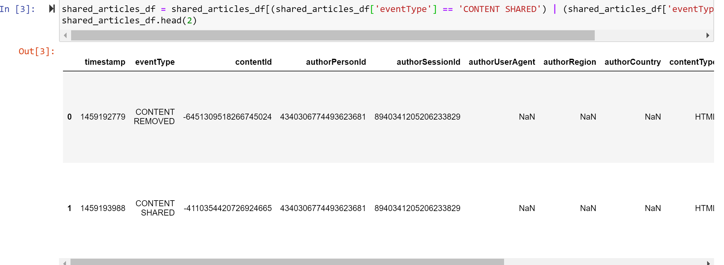
Data File1
Shared_Articles.csv – 13 features
Event_type = CONTENT_SHARED

Slide 5
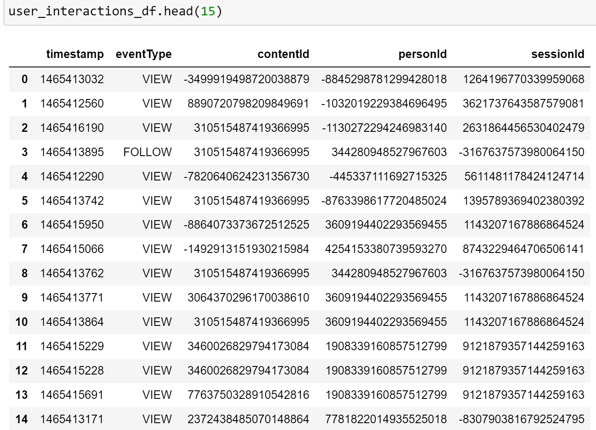
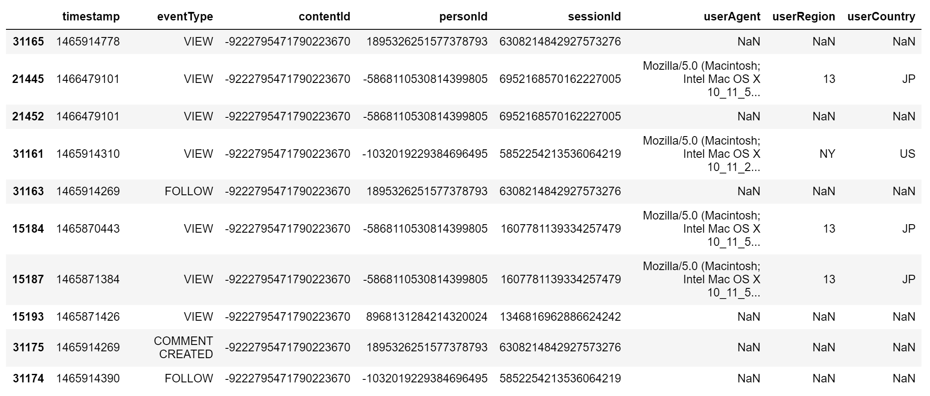
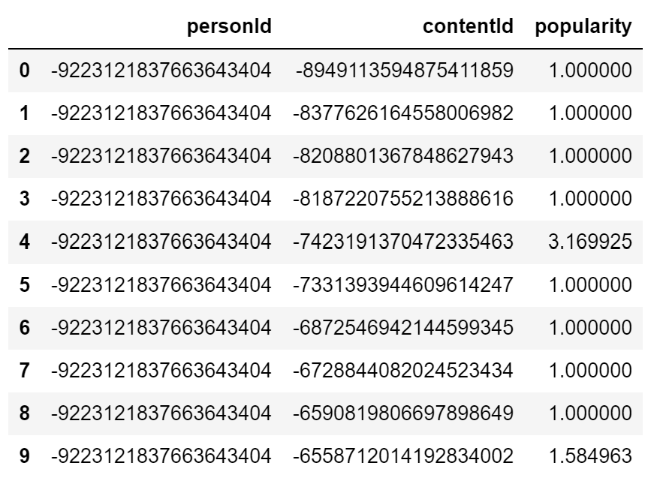
Data File2
Shared_Articles.csv – 13 features
Event_type = CONTENT_SHARED

Slide 6
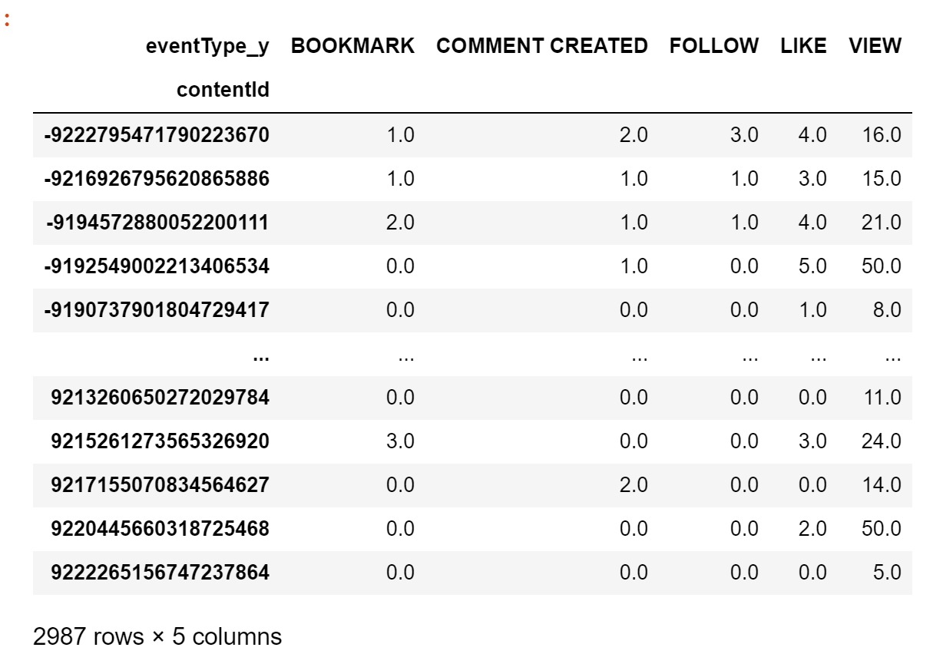
Feature Adjustment

Slide 7
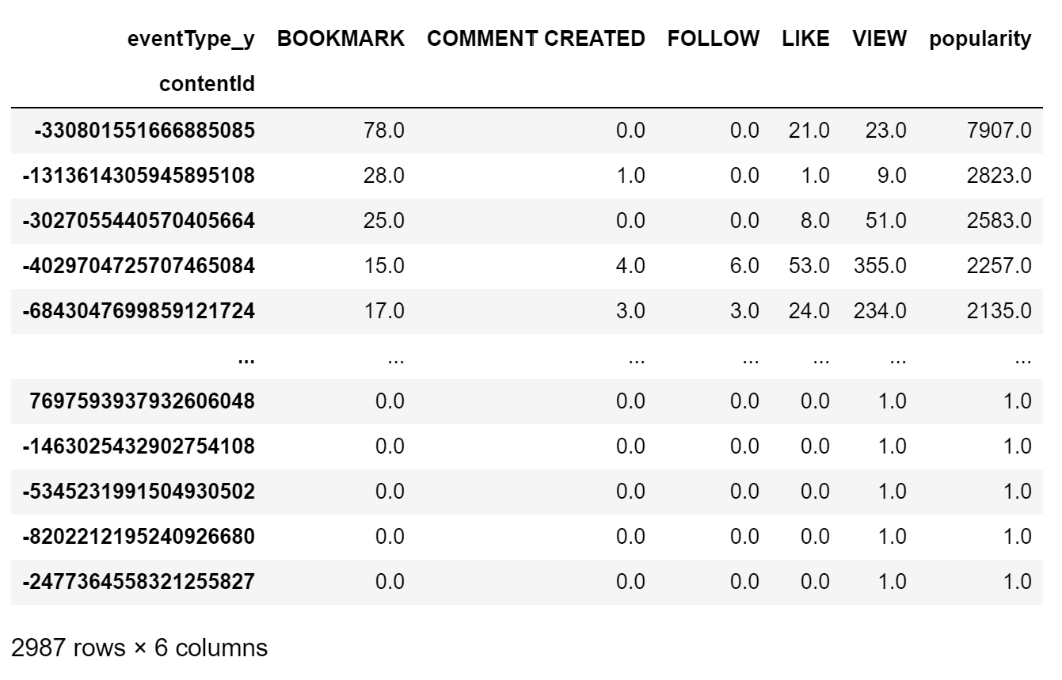
Define Popularity
Popularity = (1* VIEW) + (4*LIKE) + (10*COMMENT CREATED) +( 25*FOLLOW )+ (100*BOOKMARK)

Slide 8
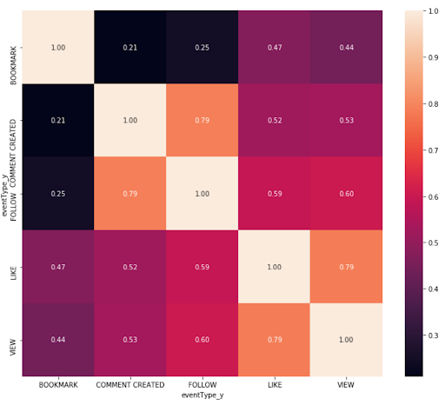
Correlation
• View-Like
• View – Follow
• Comment Created – Follow
Notes:
From the correlation matrix, the following features have strong correlation between them (>0.5).
• View-Like
• View – Follow
• Comment Created – Follow

Slide 9
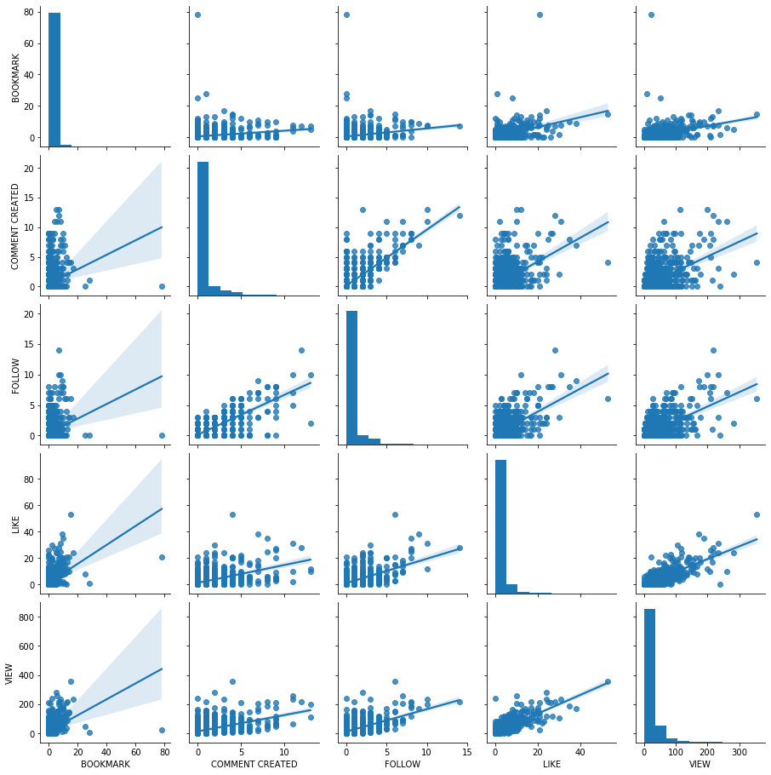
Visualization
Strong relationship between:
• View-Like
• View – Follow
• Comment Created – Follow

Slide 10
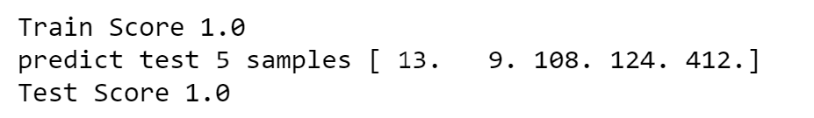
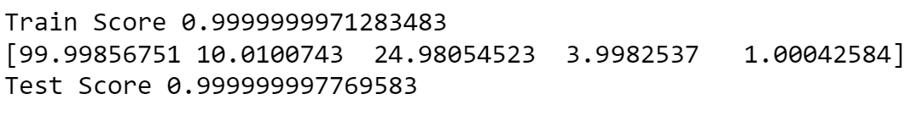
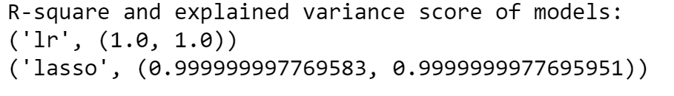
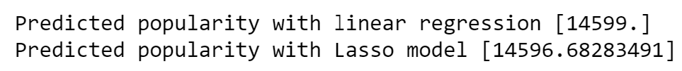
Popularity Prediction
Data Split:
Vanilla
Result:
Lasso
Result:
Explained variance:
Article input:

Slide 11
Collaborative Filtering Recommender
Notes:
Collaborative does not concern itself with non-abstract features of an item, but rather uses the wisdom of the crowd to generate recommendations.

Slide 12
Collaborative Filtering
User-user recommendation:
Score | Person1 | Person2 | Person3
Content1 | 5 | 2 | 4
Content2 | 3 | 4 | 3
Content3 | 1 | 4 | 1
Content4 | 2 |  | ??
Content5 | 5 | 2 | ??
Item-item recommendation:
 | Content1 | Content2 | Content3 | Content4 | Contet5
Person1 | 5 | 3 | 1 | 2 | 5
Person2 | 2 | 4 | 4 |  | 2
Person3 | 4 | 3 | 1 | ?? | ??
Notes:
Goal – suggest content to Person3. In user to user approach we try finding similarities between users based on their interactions with items. In this case person1 and person3 are more similar to each other compared to person2. So we could recommend content5 to person3.
In item to item filtering approach we try finding the content which is similar to the ones that a person has interacted with.

Slide 13
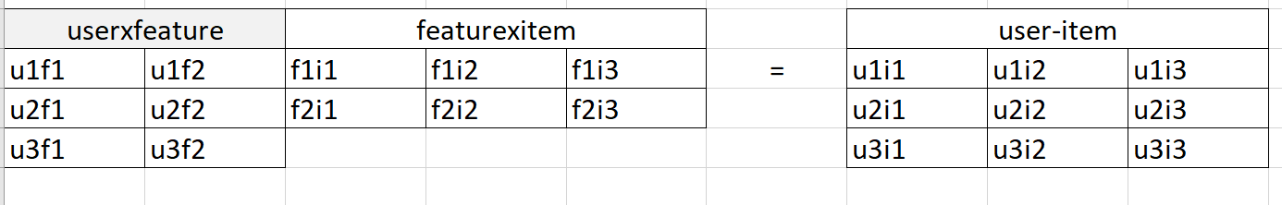
Matrix Factorization
Notes:
I have decomposed the user-item preference matrix singular value decomposition (SVD) into three elements: the user-feature eigenvectors, the feature-item eigenvectors, and a diagonal matrix of eigenvalues. Decomposing a user-item matrix into terms of latent features is extremely useful. SVD is more powerful than user-user or item-item factorization.

Slide 14
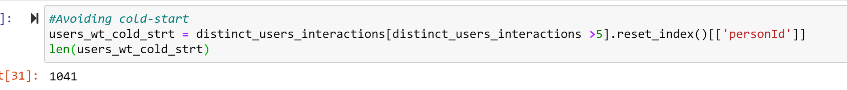
Cold-Start Problem
Avoid cold-start in the beginning
Notes:
Recommender systems have a problem known as user cold-start, in which is hard do provide personalized recommendations for users with none or a very few number of interacted items, due to the lack of information to model their preferences.
To avoid Cold start we take only those records which have more than 5 interacted items.

Slide 15
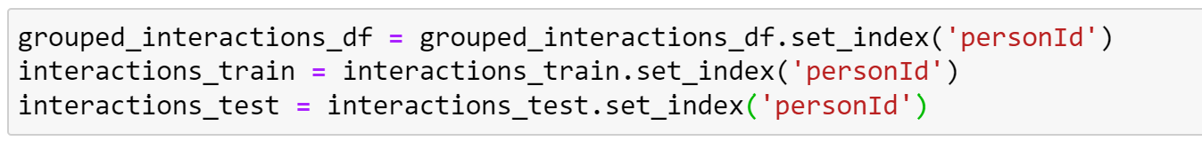
Train_Test Split
Notes:
To start with, I grouped the data frame with more than 5 user interactions with personId and ContentID. Then split the resultant data frame for training and testing the recommendation system into 80:20 ratio. Then we set an index with personID so that the search is faster for evaluations.

Slide 16
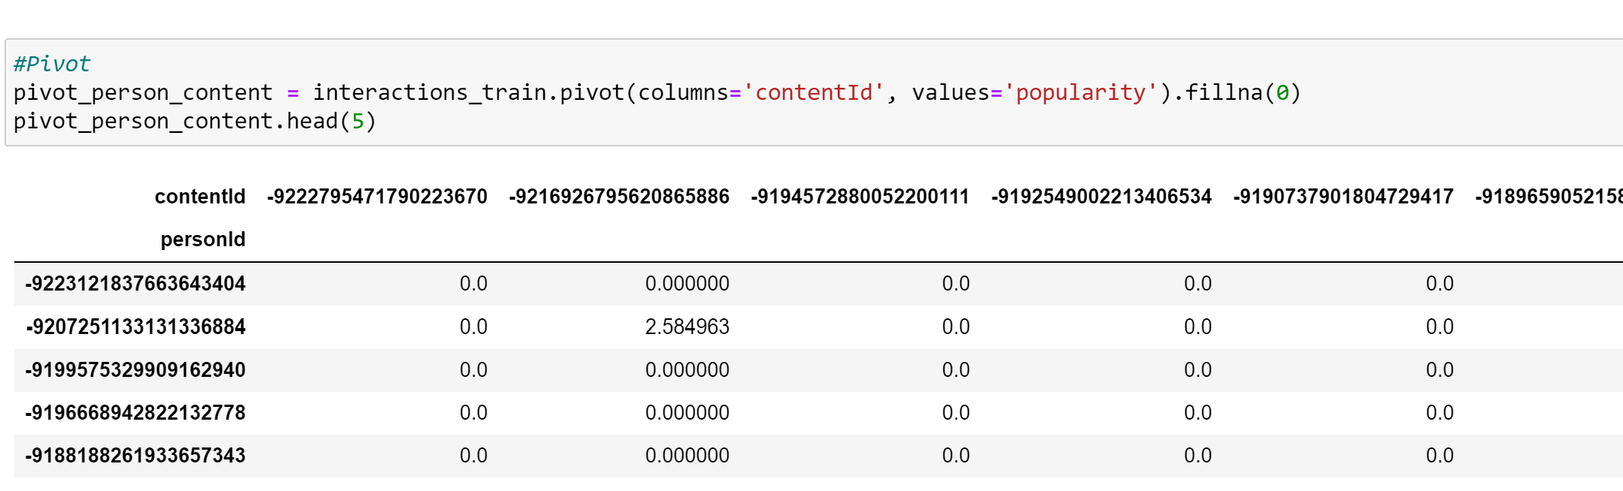
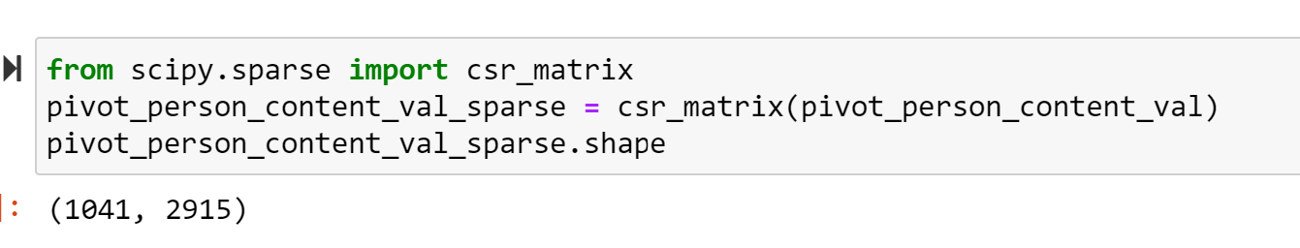
Pivot Table
Notes:
Next, I created a sparse matrix. I started with pivoting the current training dataset with personID as rows and contentID as columns.

Slide 17
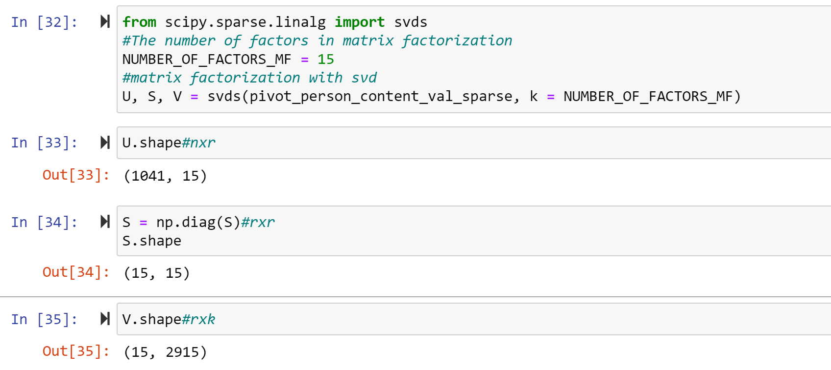
Matrix Factorization
Notes:
Using scipy package for svd is preferable because we can specify the rank in this.
We decompose the popularity matrix as U the person “features” matrix, S the diagonal matrix of singular/eigen values which means weights to the features, and VT is the content “features” matrix. U represents how much persons “like” each feature and VT represents how relevant each feature is to each content.
feature is to each content.

Slide 18
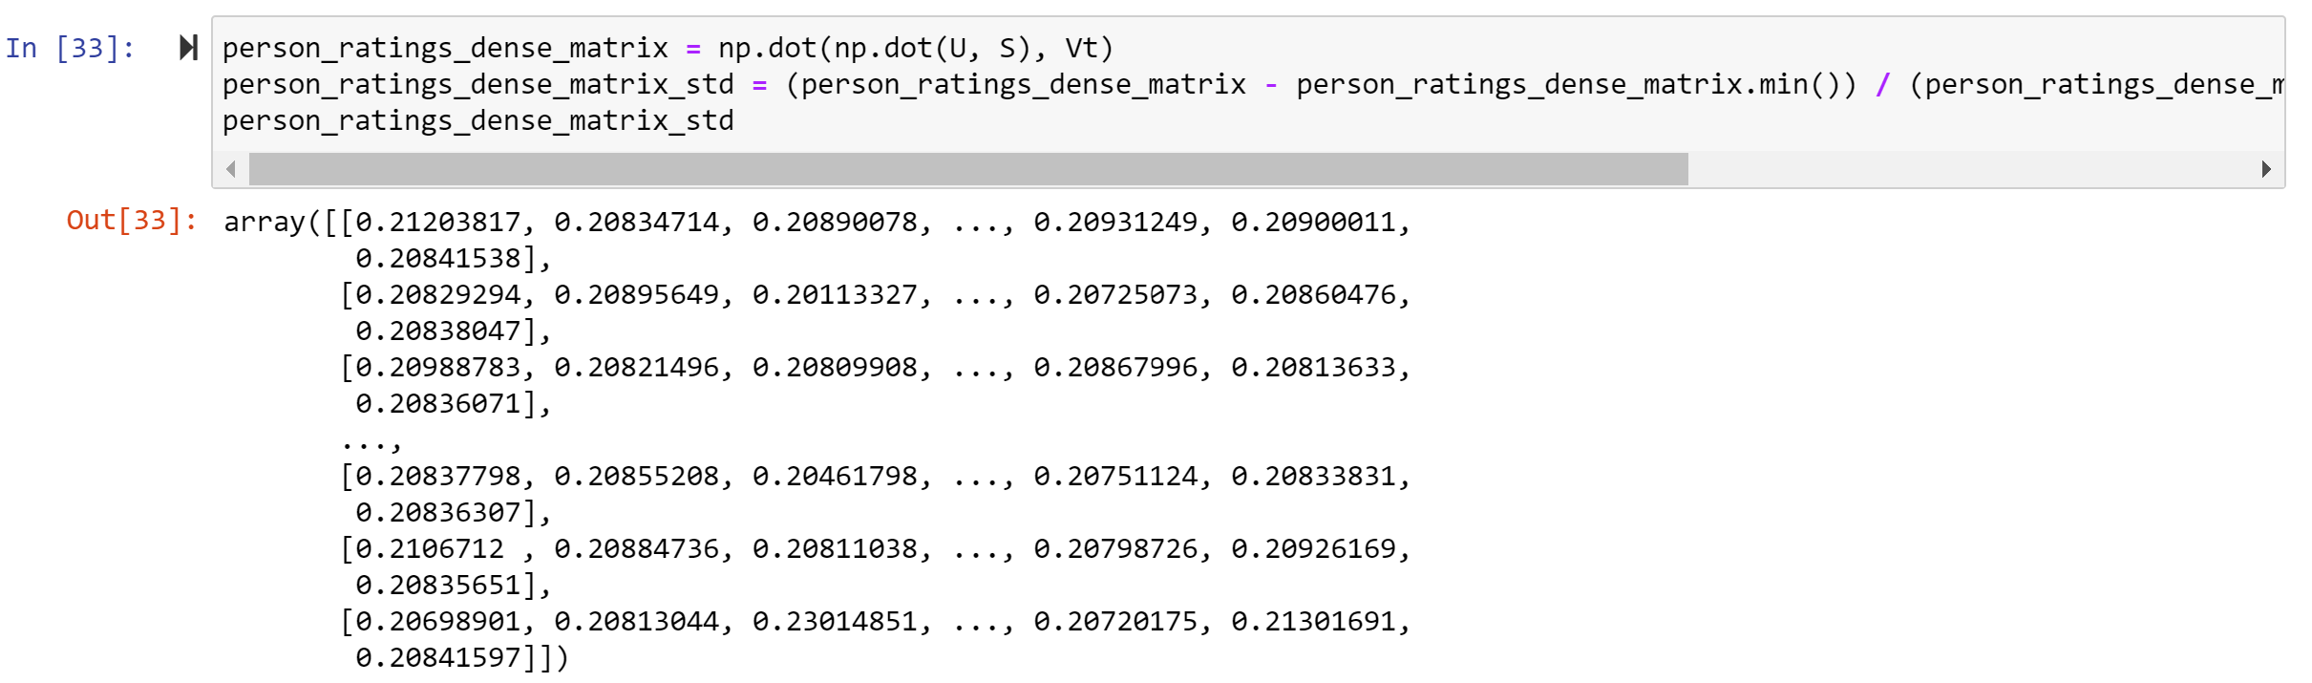
Reconstruction of Matrix
Notes:
After the factorization, we try to to reconstruct the original matrix by multiplying its factors. So, the resulting matrix is not sparse anymore. It was generated predictions for items the user have not yet interaction, which we will exploit for recommendations.

Slide 19
Interacted Items
Notes:
We find the list of contants interacted by a personID

Slide 20
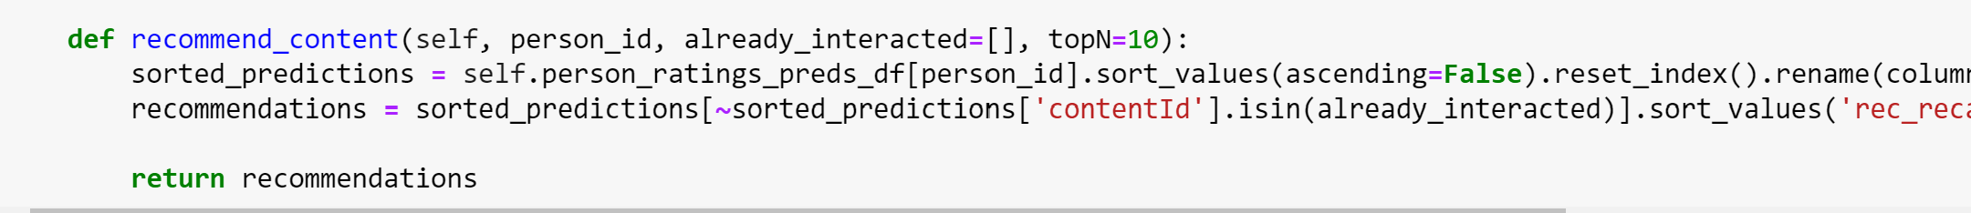
Recommend Content
Notes:
Using the person and content matrix we got after matrix decomposition we find the sorted values of similar contents. We ignore all the items that the person has already interacted with. And recommend the top 10 of the rest of similar items.

Slide 21
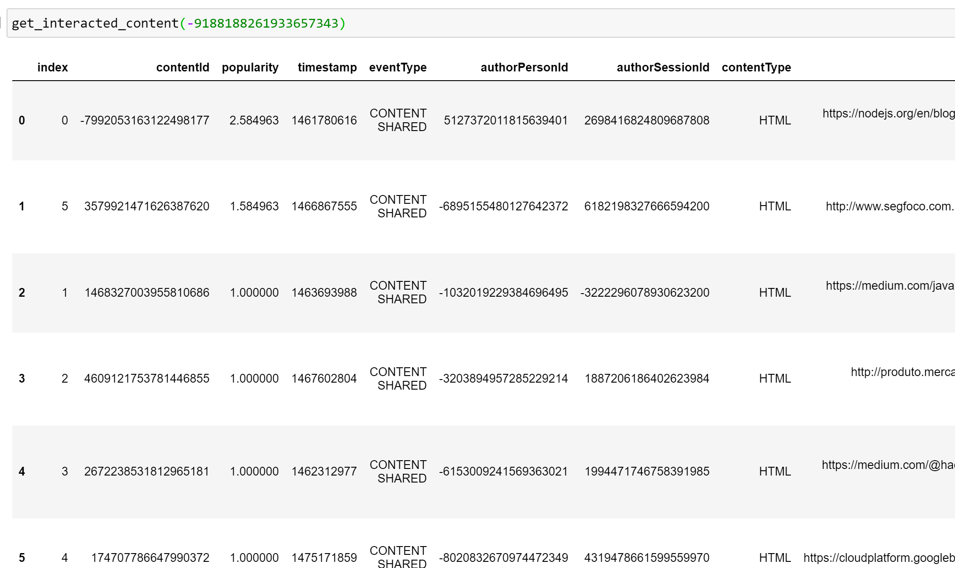
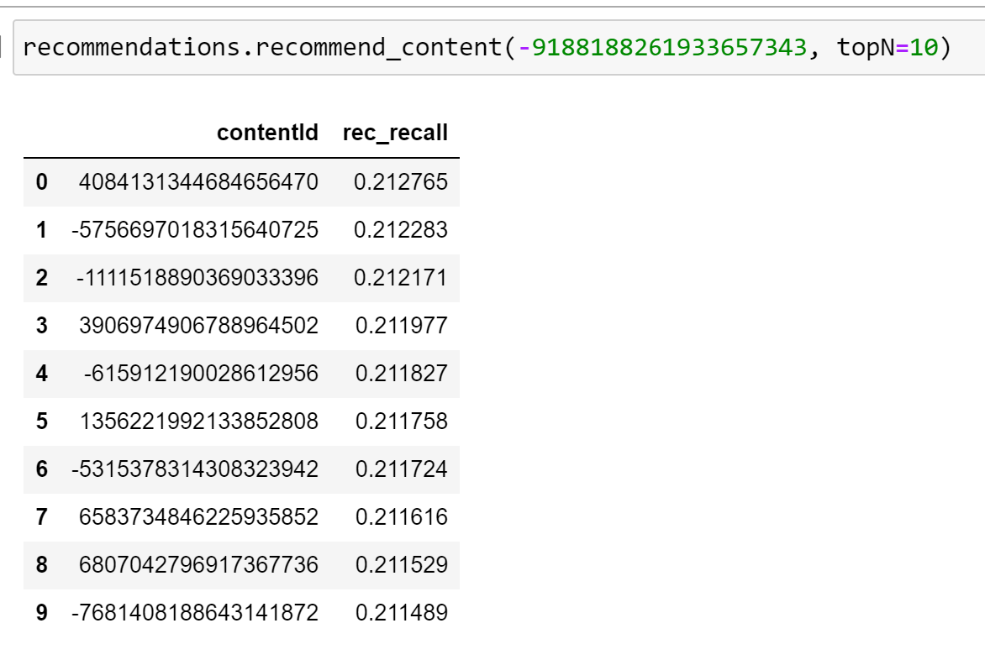
Test
Notes:
Here is a test for a personID. First we get the already interacted contents. And then we get recommendations on what other content that person can interact with.

Slide 22
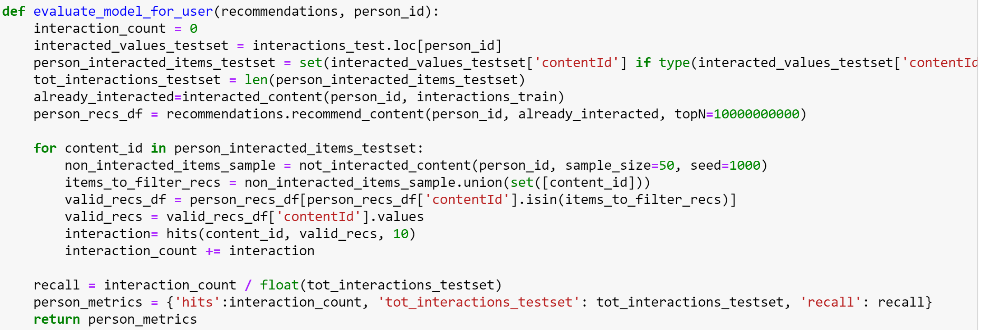
Evaluation of the Model
Notes:
For each user
For each item the user has interacted in test set
Sample 50 other items the user has never interacted. Recommender model to produces a ranked list of recommended items, from a set of one interacted item and the 50 non-interacted items
Compute one persons Top-N recall evaluation

Slide 23
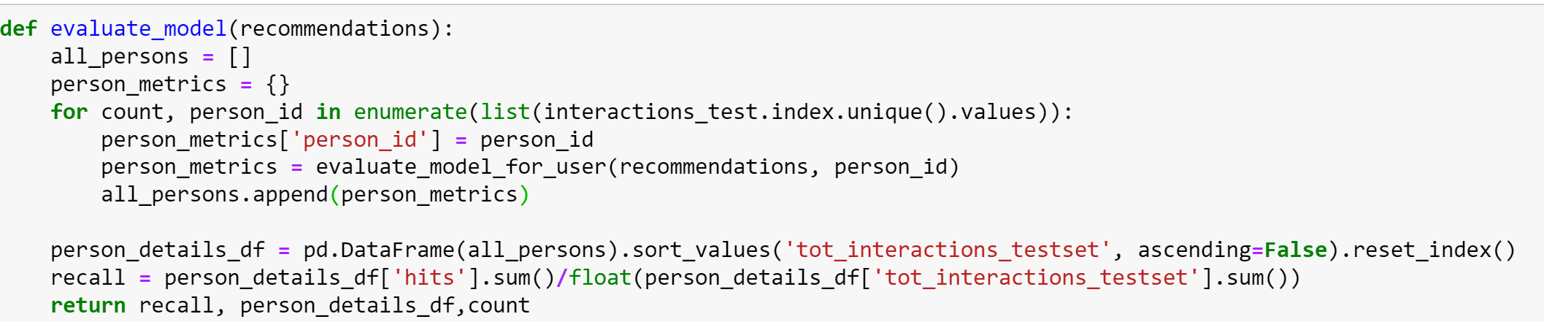
Evaluation of the Model
Notes:
Aggregate the Top-N recall evaluation for all persons in the dataframe.

Slide 24
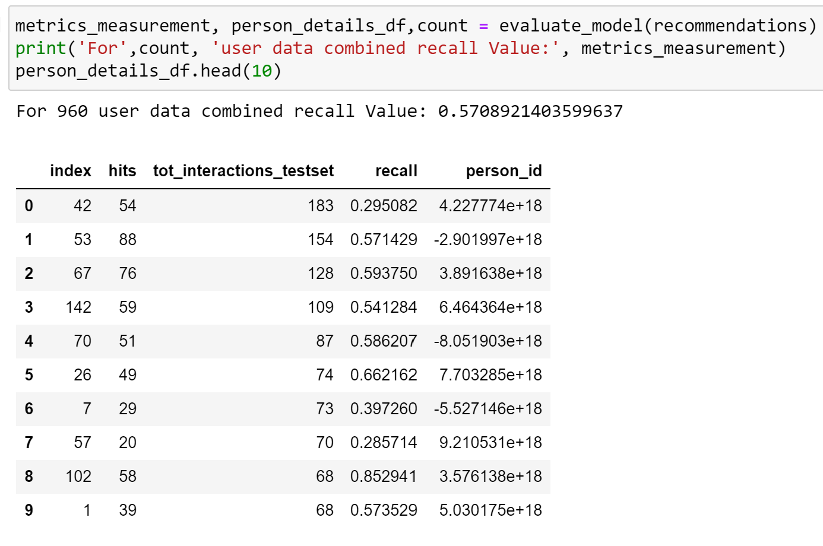
Evaluation Result
Notes:
The recall value we get here is 0.57. This means that in 57% of the recommendations of contents made by the system matches the prefrerences of the user.

